Slide 1

Developer Operations
(DevOps)
There is 1 show & tell among us

Slide 2
Table of Contents
01
02
03
04
DevOps
DevOps Philosophy
DevOps vs Cloud. Is it just tooling? Growth prospects
Automate, build, test, CI/CD pipelines
Software Architecture
Service Oriented Architecture
The basic principles over why DevOps
Microservices & Container Orchestration, Docker Demonstration

Slide 3
Table of Contents
05
06
07
SOA, New Challenges
IaaS, PaaS, SaaS
Container Orchestration, Tagging, Networks, Monitoring
AWS, GCP, pizza, all that kind of stuff
DevOps SIG
CI/CD Foundation, MLOps, Cloud Native Tooling

Slide 4
01
DevOps!
DevOps vs Cloud. Is it just tooling? Growth prospects

Slide 5
— Someone Famous (Me)
“Faster delivery of products through combination of practices (IMPORTANT) and tools”
(We’ll come back to the Cloud later)

Slide 6
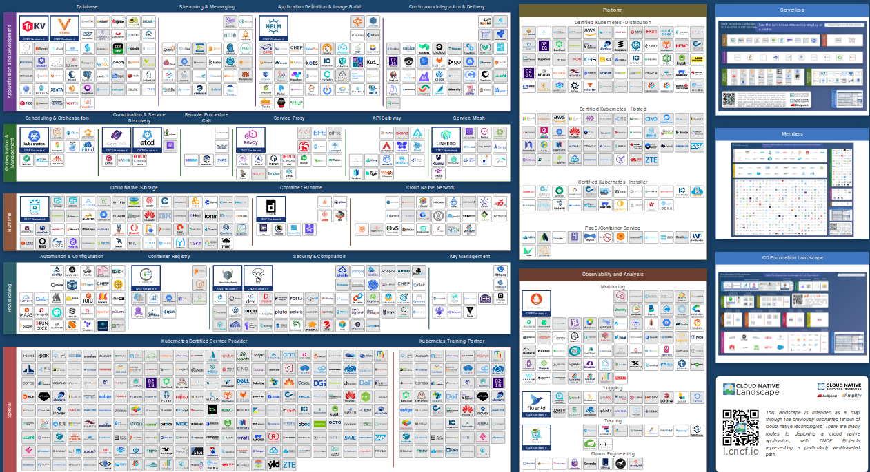
What do I get to work with?
You are viewing 929 cards with a total of 2,614,739 stars, market cap of $16T and funding of $17.1B - CNCF

Slide 7
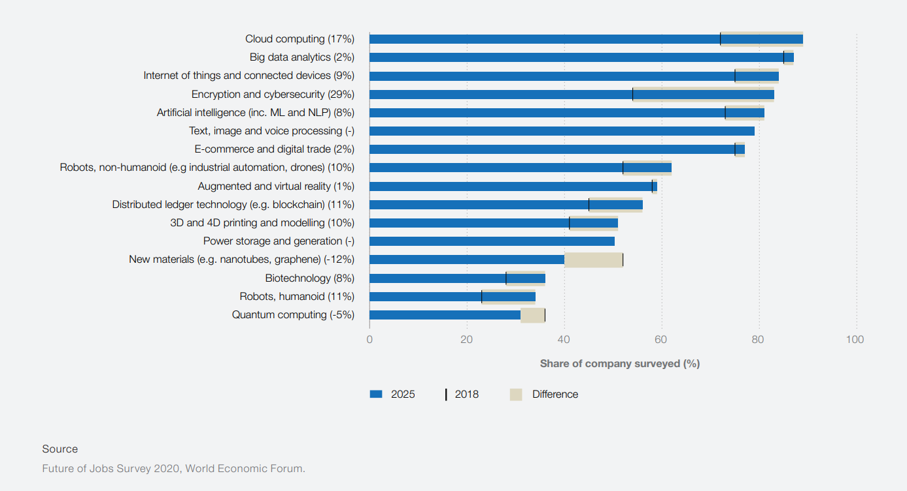
DevOps Sounds Cool! How Quickly Is It Growing?

Slide 8
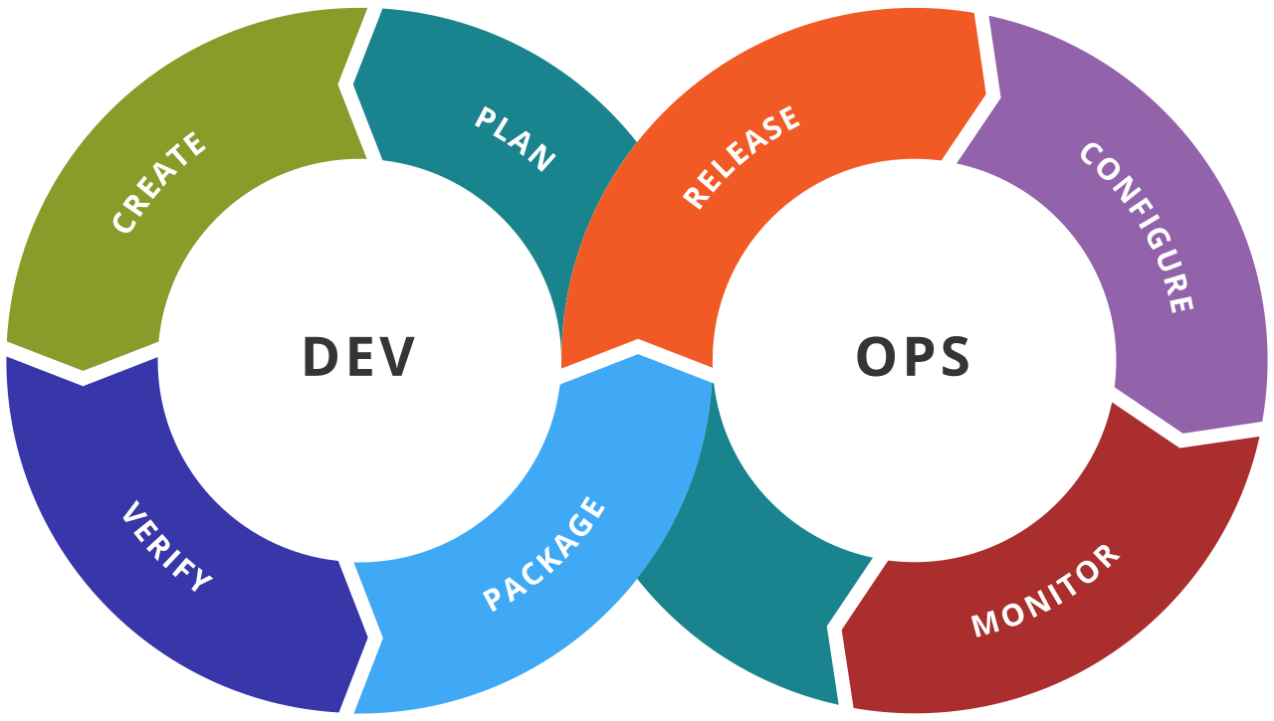
02
The Philosophy
Automation, Building, CI/CD

Slide 9
Where The Conflict Comes From
Developers
Operations
“Congratulations, you’re a member of the developers. You’re focus is on making features as fast as possible while getting paid for it”
“Congratulations, you get sabotaged by the developers. That means you’ll want things to be as stable as possible, without changes”

Slide 10
How to Deal With It?
Recognizing problematic areas early on
Develop, build, test, push, monitor problems!
Team joins organization
Step 1
Step 3
Step 5
Step 2
Step 4
Doing a proper plan and analysis
Decide on a flow that eliminates bottlenecks (make Devs and Ops BFFs)

Slide 11
So What Does The Ops Do?
Objective: Production Shipping
Designing Processes and Systems
Setting Up Networking And Infrastructure
Codebase configuration, updating, troubleshooting
Detecting outrages, performance, bottlenecks

Slide 12
MLH FellowShip Sessions
Faun Publication
Fun Fun Function (!!!)
Introduction To Prometheus/Cloud Native Chaos Engineering/Non Code Contributions
The Must-Know Checklist For DevOps & Site Reliability Engineers
Continuous Integration - What's the point?

Slide 13

03
Software Architecture
Reliability, Maintainability, Scalability, and moving towards containerization

Slide 14
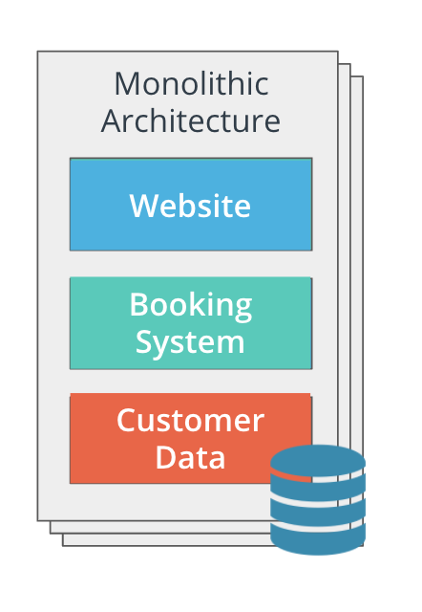
Architectures
01
Monoliths
Everything is one unit
Managed in a single repository
Sharing existing resources (CPU & Memory)
Mostly single programming language
Single binary

Slide 15
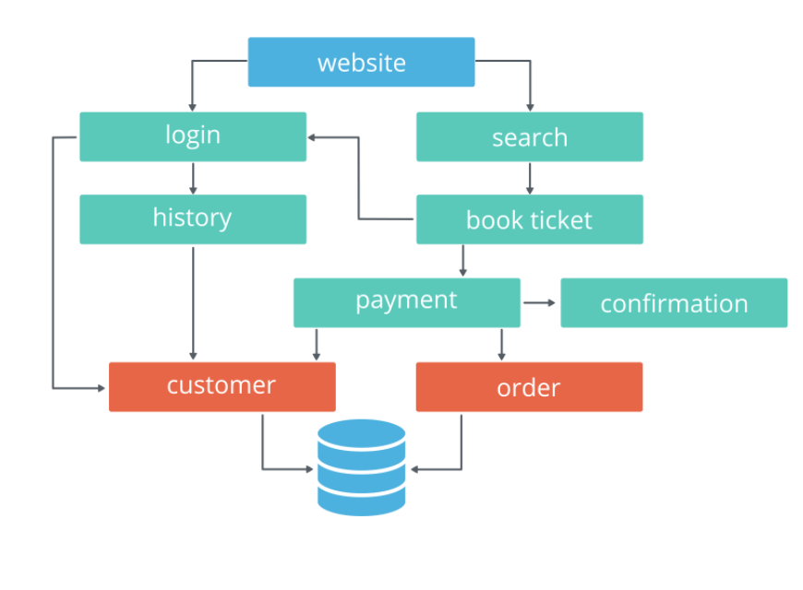
02
Microservices
Each “service” is managed in a separate repository
Every “service” has their own allocated service
An API for communication
The tools, frameworks, SDKs are of choice
Each “service” has its own binary

Slide 16
04
Service Oriented Architecture
Some best practices before we move on, or what to expect in microservices

Slide 17
The Imposter (MicroService)
Objective: Services, autonomy, Reusing components
Health Checks - how to make sure nothing goes down?
Logging - what is a service even doing/
Metrics - for quantifying performance
Tracing - how many services does one interact with?

Slide 18
4.1
Docker Demo
Quick show of how Docker works

Slide 19
05
SOA - New Challenges
Microservices brings with it is own set of challenges

Slide 20
SOA Challenges
Task | “Solved” With
Orchestration | Kubernetes
Metrics | Prometheus, Grafana
Configuration Management | Helm
Tagging | Pushing/Pulling from Docker Hub
Networks | Istio, Meshery, Service Meshes

Slide 21
06
IaaS, PaaS, SaaS
But where you even “deploy” your code base?

Slide 22
We’re Almost At The End

Slide 23
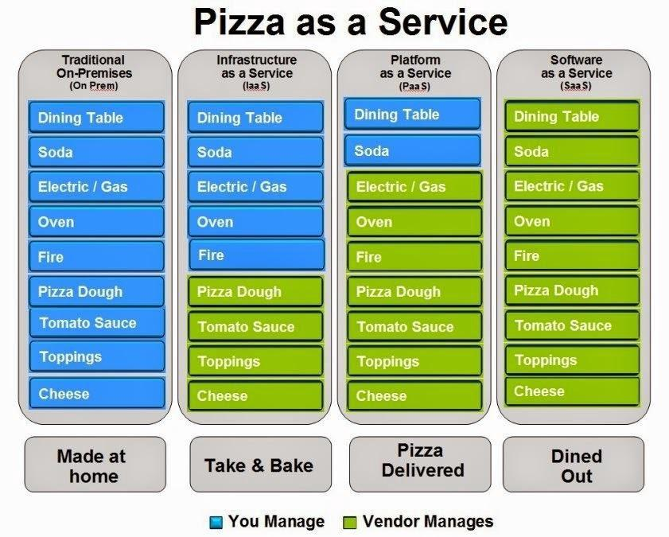
But First, Pizza As A Service

Slide 24
07
DevOps Special Interest GRoups, SIG
Further alternatives you can look at

Slide 25
CD Foundation
CD Foundation is an open-source community improving the world's ability to deliver software with security and speed.

Slide 26
MLOps
A set of practices that aims to deploy and maintain machine learning models in production reliably and efficiently.
#ModelMonitoring, #ModelRegistries, #MachineLearningEngineeringForProduction
Deep Learning Specialization

Slide 27
Cloud Native Cloud Foundation
All things cloud and cloud native related, open source, community based, funded and has programs for ambassadors

Slide 28
Thanks!
Do you have any questions?
Please keep this slide for attribution

Slide 29


